Slide 1
So you want to do craft shows?
Dave Lutzkanin and Lani Nichols
Windy Hill Woodturning

Slide 2
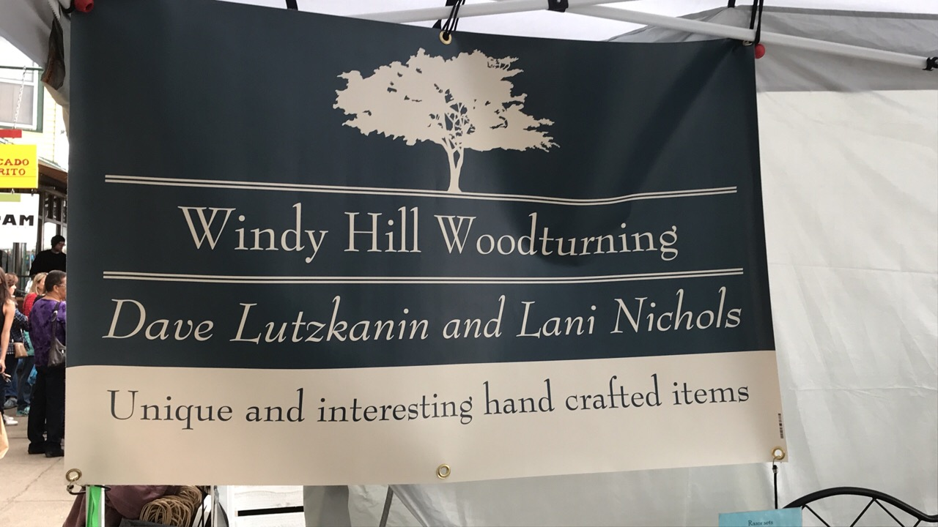

Slide 3
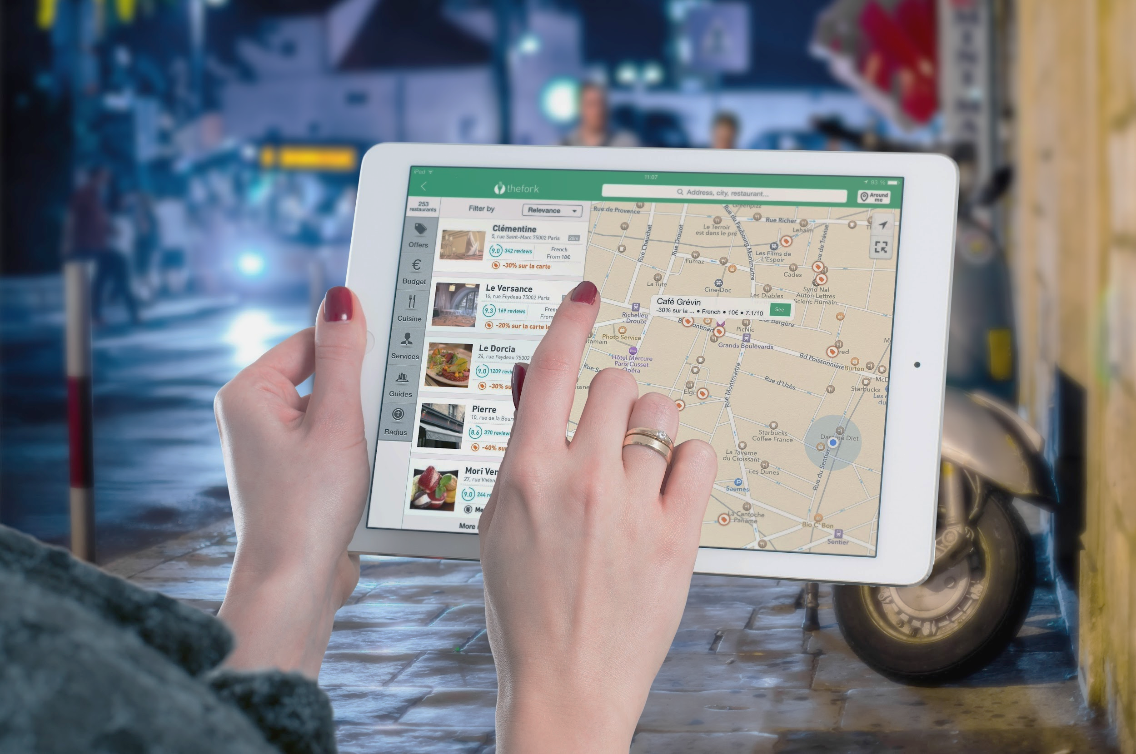
Locating shows
-Talk to vendors at shows
-Google / art fair insiders/ etc
-Juried only, with exceptions
-Beware of shows with alcohol i.e. wine festivals
-Attend a show the year before applying if possible

Slide 4
Expenses to consider
Application fees and jury fees are standard
Canopy? Must be strong enough to withstand severe weather. Hold it down! Walls are necessary
Display?
Business cards, banner, price tags, signs, bags, boxes, tissue paper
Business insurance, AAW discount through the Hartford Co.
Tax purposes, sole proprietor, LLC or S corp?
Build your inventory

Slide 5
Conducting business
Track your sales
Cashbox
Credit card reader necessary (majority of sales are cards) Square / Paypal
Tax collection license from state, required for the majority of shows.

Slide 6
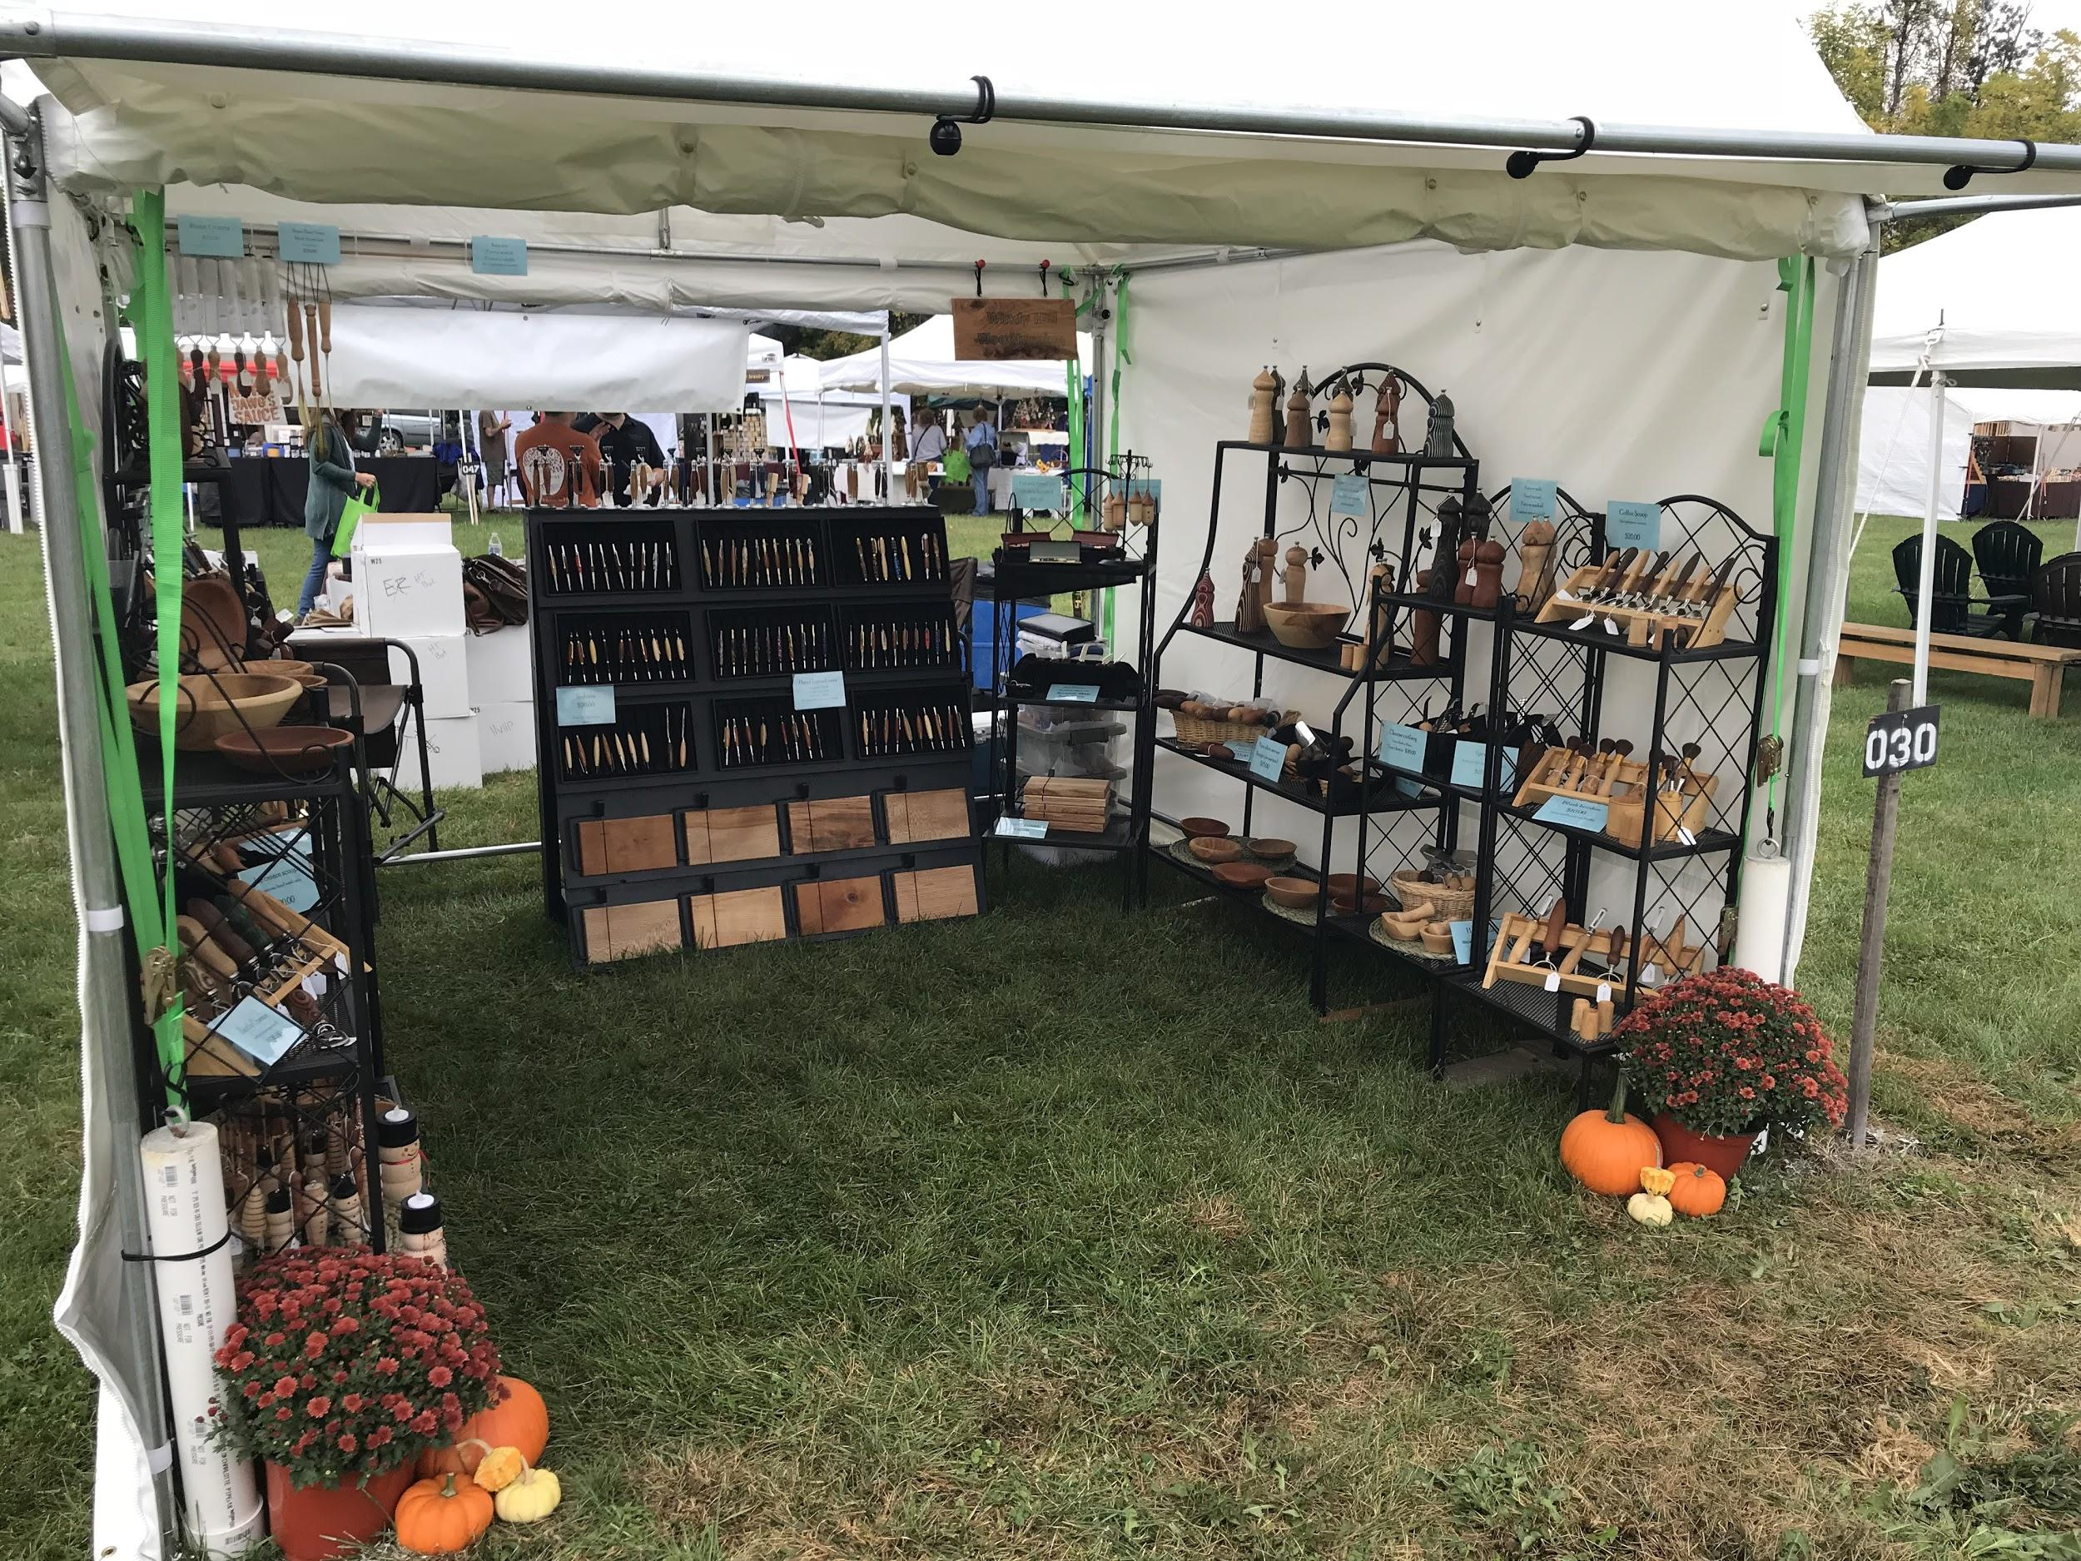
Booth setup
Display - avoid just using tables. Most expensive items at eye level!
Avoid clutter, is it too “busy”?
The display should not overshadow the product.
Can it withstand wind? Rain? Muddy ground? Etc…
Take shims, ground is rarely level, even on concrete.
Need a space to “work”.
Where are you storing extra inventory?
Dress professionally for the weather

Slide 7
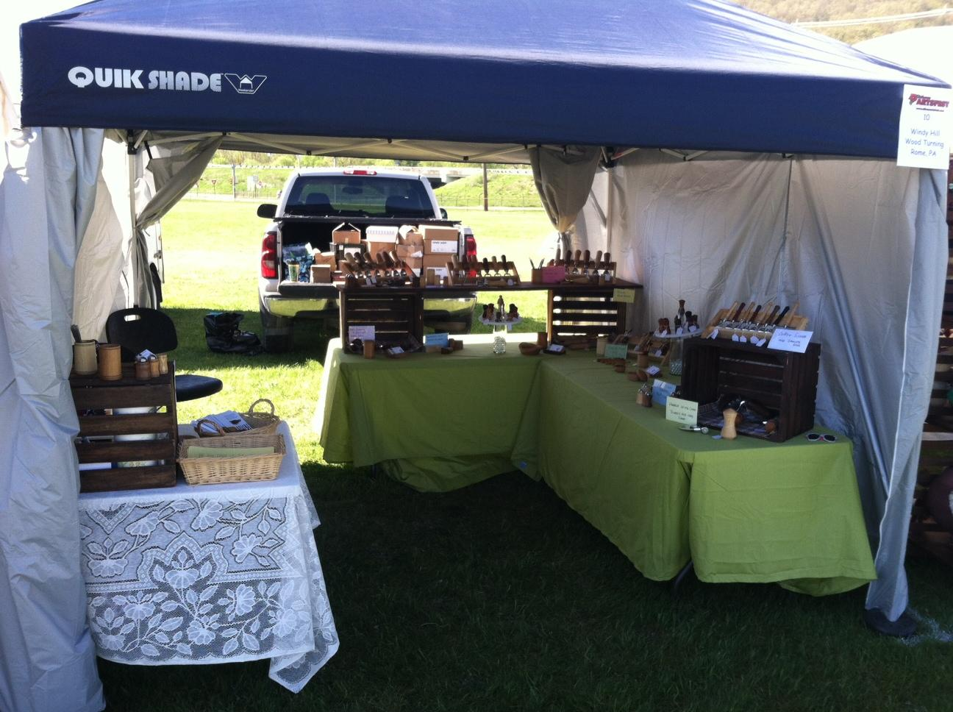

Slide 8
Figure 1 Commentary:
This picture is our booth from our first show in 2012. We have learned much since then.
There are a few things to notice here.
First, there is no identity. What’s in the booth? Who’s in the booth? What do you do or sell?
Second, nothing about the booth is attracting your attention to lure you to come look.
Please, do a better job your first time out than this!

Slide 9
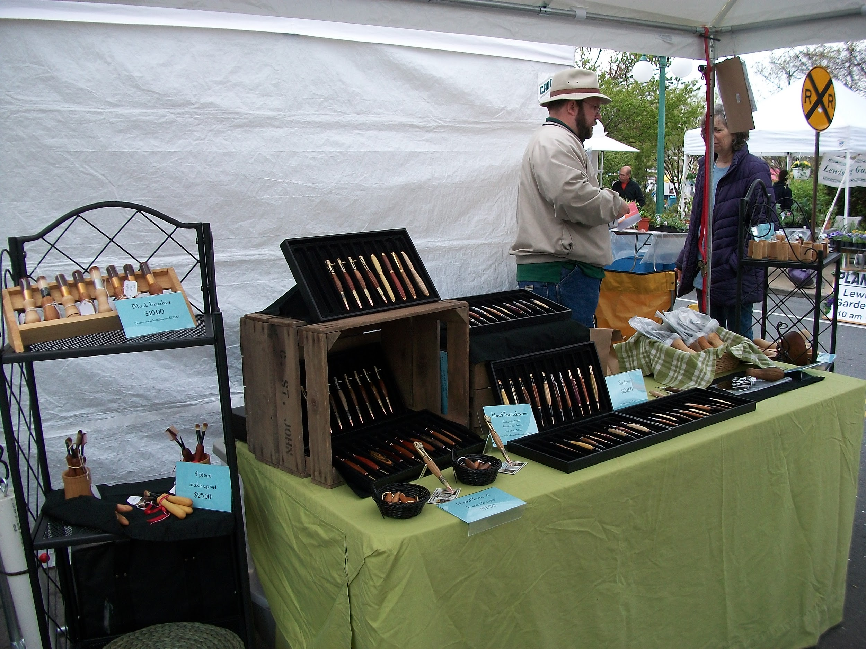

Slide 10
Figure 2 commentary:
This show was about a year later. We are still using a table to display pens. The other tables have been traded in for the black bakers racks.
Notice the cash box behind the wooden crate. Our “workspace” is also behind that table.

Slide 11
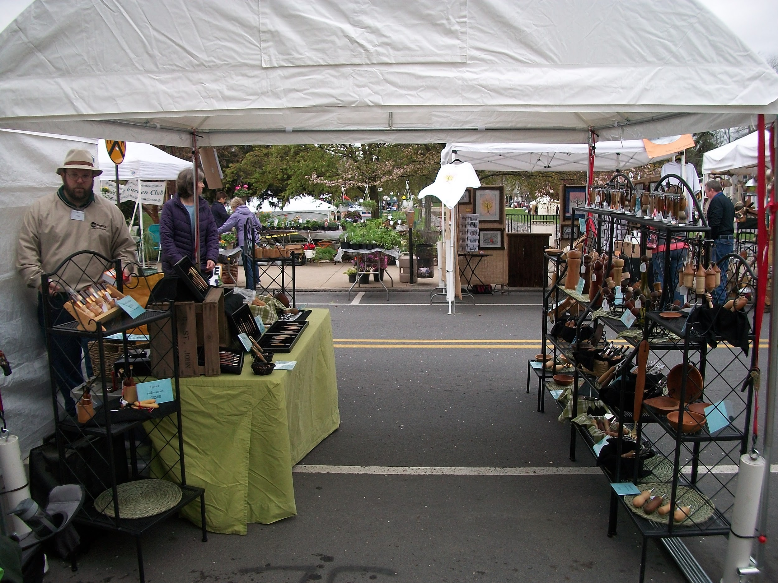

Slide 12
Figure 3 commentary.
This is another view of the full booth from the previous picture. Notice we are down to one table.
The black bakers racks look so much better. The products are so much more organized and look better on the racks than a table.

Slide 14
Figure 4 commentary.
A closer look at the bakers racks from the same show.
Note the pvc pipe filled with concrete and attached to canopy via ratchet strap. You can’t always use stakes in the ground, especially on concrete. When we are at a show that’s on grass, we use BOTH the stakes and weights. Two ratchet straps on each corner. This provides much stability!
The pvc pipe was filled with rocks and then concrete added. It takes a few hours to make. The eye hooks are embedded in the concrete. I used washers on the hooks to prevent them from pulling out of the concrete.
Notice the signs in the plastic picture frames. Using the signs allows for group pricing by item. If a price change is necessary, you only have to print out a new sign, rather than change each individual tag. Our items do have tags, which indicate wood species. Some items, like bowls and pepper mills, are indeed priced individually. We use stickers on the bottoms of bowls.
Canopy walls would assist in seeing our product.

Slide 15
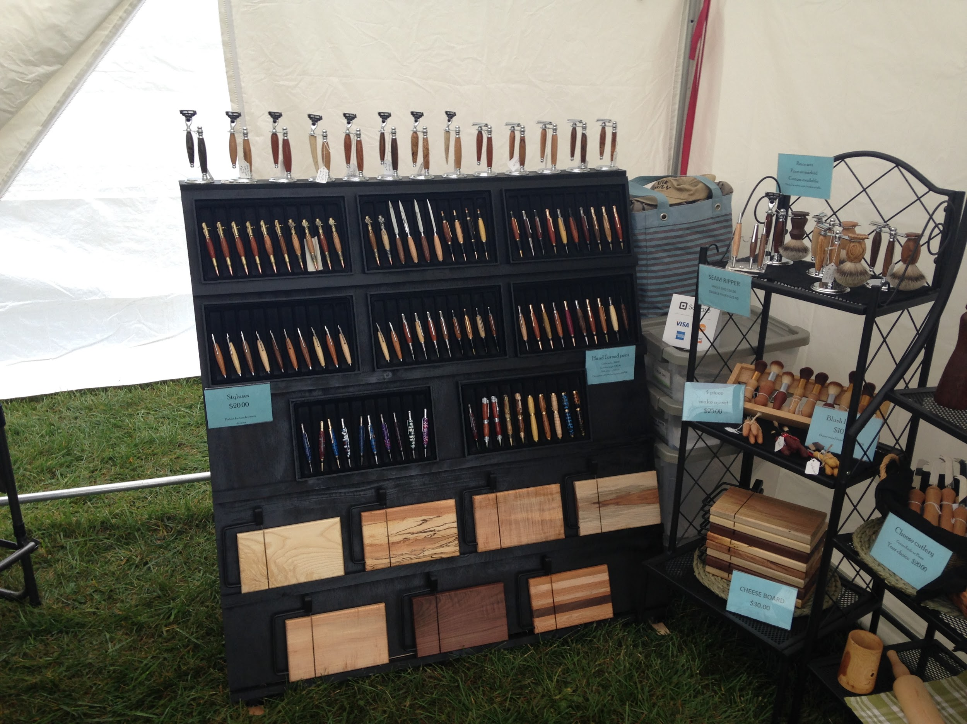

Slide 16
Figure 5 commentary.
We decided on a better way to display pens and razor sets. This rack shows that effort. The razor sets are now at eye level to the customer. The pens are displayed rather nicely.
This rack really makes the booth! A shelf was built into the rear of the rack for our “workspace.” The cash box, business cards, gift boxes, bags and other sales necessary items are here. We even added a wood dowel to hold the tissue paper for items that need wrapped prior to bagging. The bottom of the rear of the rack also assists in storing extra inventory.
Speaking of extra inventory...look in the corner. We didn’t like that our extra inventory totes and other stuff were exposed behind our display. You will see a fix to that later.

Slide 17
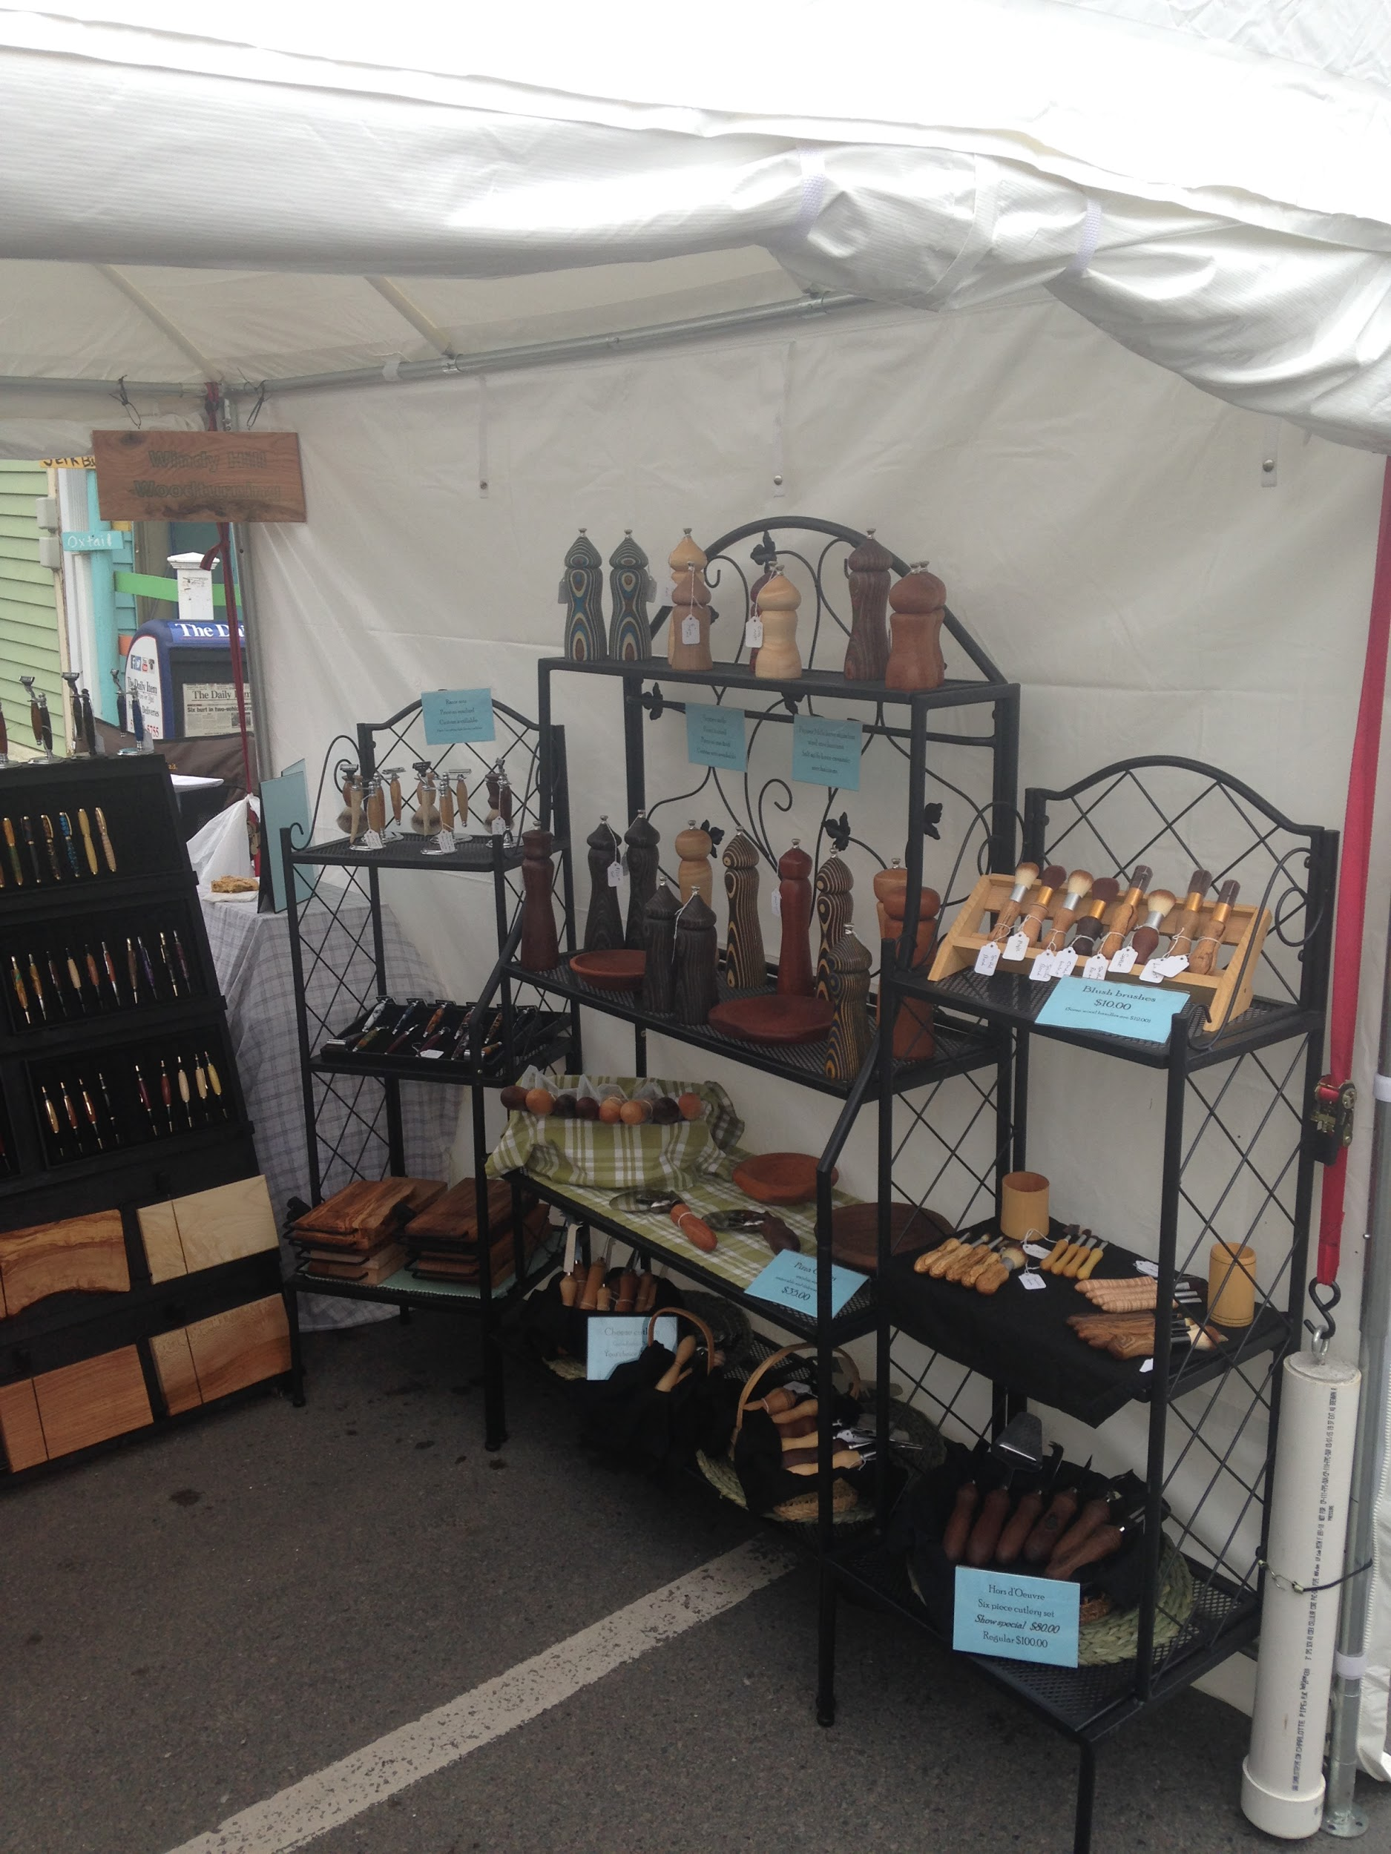
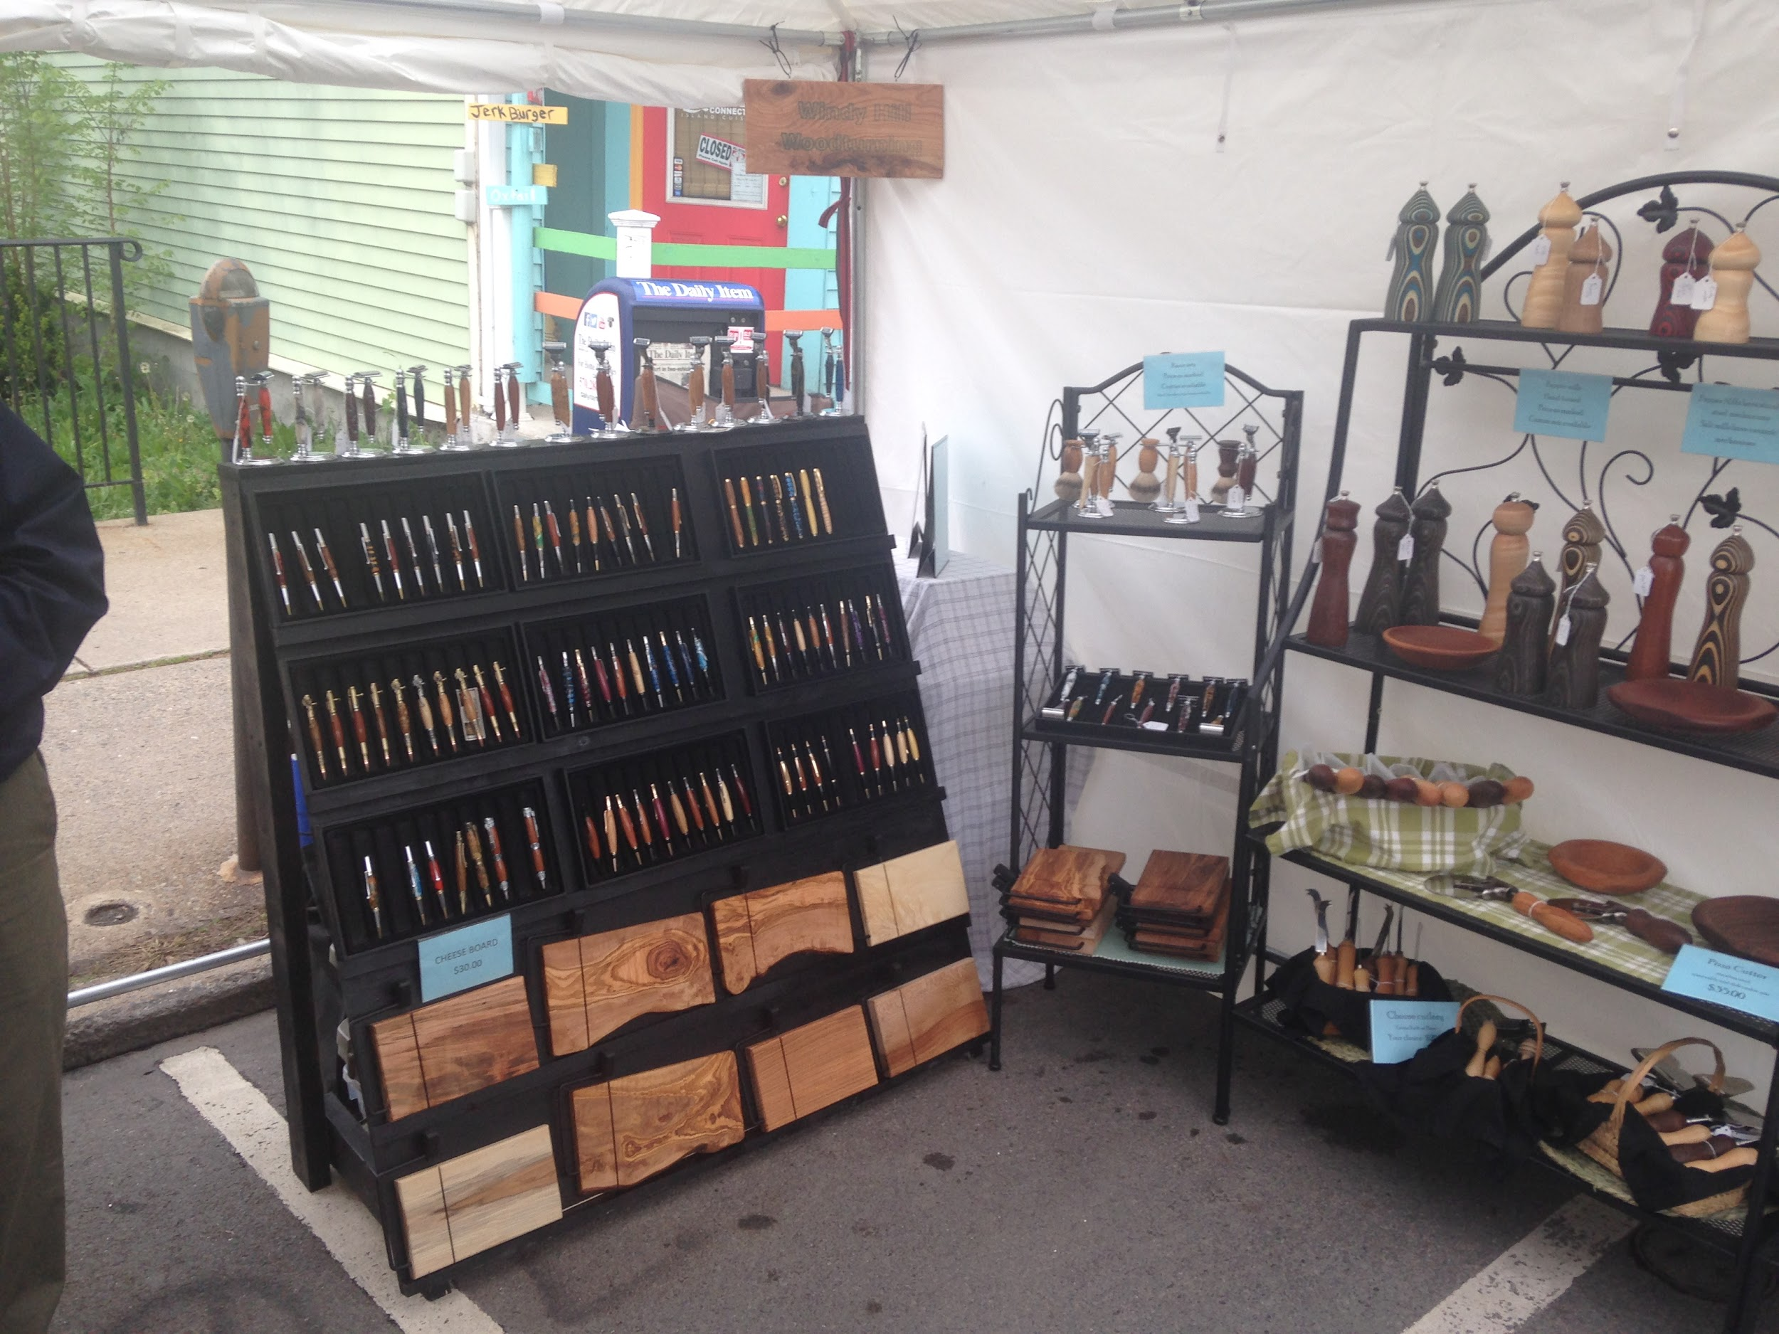

Slide 18
Figures 6 and 7 commentary
Another view of that corner of the booth.
Notice the extra inventory behind the rack is covered with a cloth. Better, but still not great.
By the way, can you guess when the razor set, pens and pepper mill sales increased drastically? Yep, a better display enhances sales!
The pen rack with the razors on top draw people into the booth. The pepper mills on the top shelf also catch people’s attention.
Platters and large bowls are usually top shelf of the opposite side of the booth.
One of my students at school in shop class made the wooden sign for me.

Slide 20
Figure 8 commentary.
Can you tell this is a fall show? Decorating for the season does, indeed, help your booth stand out from the crowd. (I let my fiance’ do the decorating)
This booth is a far cry from our first set up and still needs some tweaking. We still don’t like that corner with the boxes behind the racks.
Notice that each corner of the canopy has two ratchet straps. One goes to the weight, the other to a twist-in stake. Don’t use straight stakes, they pull out. We use the twist-in stakes that are for livestock. The ones for pets are too thin and snap off.
Which color ratchet strap looks better? The green or the red from earlier pictures? Did you even notice? I agree, the green looks so much better!
Also, notice the front and rear awnings of our canopy are installed in this picture. Canopies are a valuable addition to your canopy purchase. You can’t see it here, but our canopy was ordered with optional vents on the gable ends. This really helps air flow on hot summer days. Also, our walls were ordered with a zippered “door.” These extras have proven to be worth every penny when needed.

Slide 21
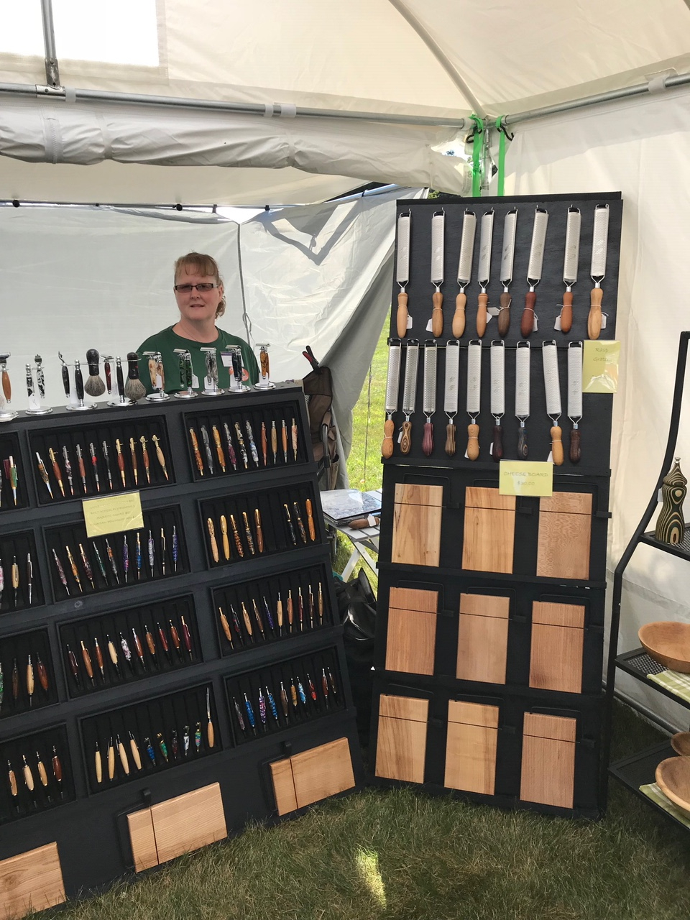
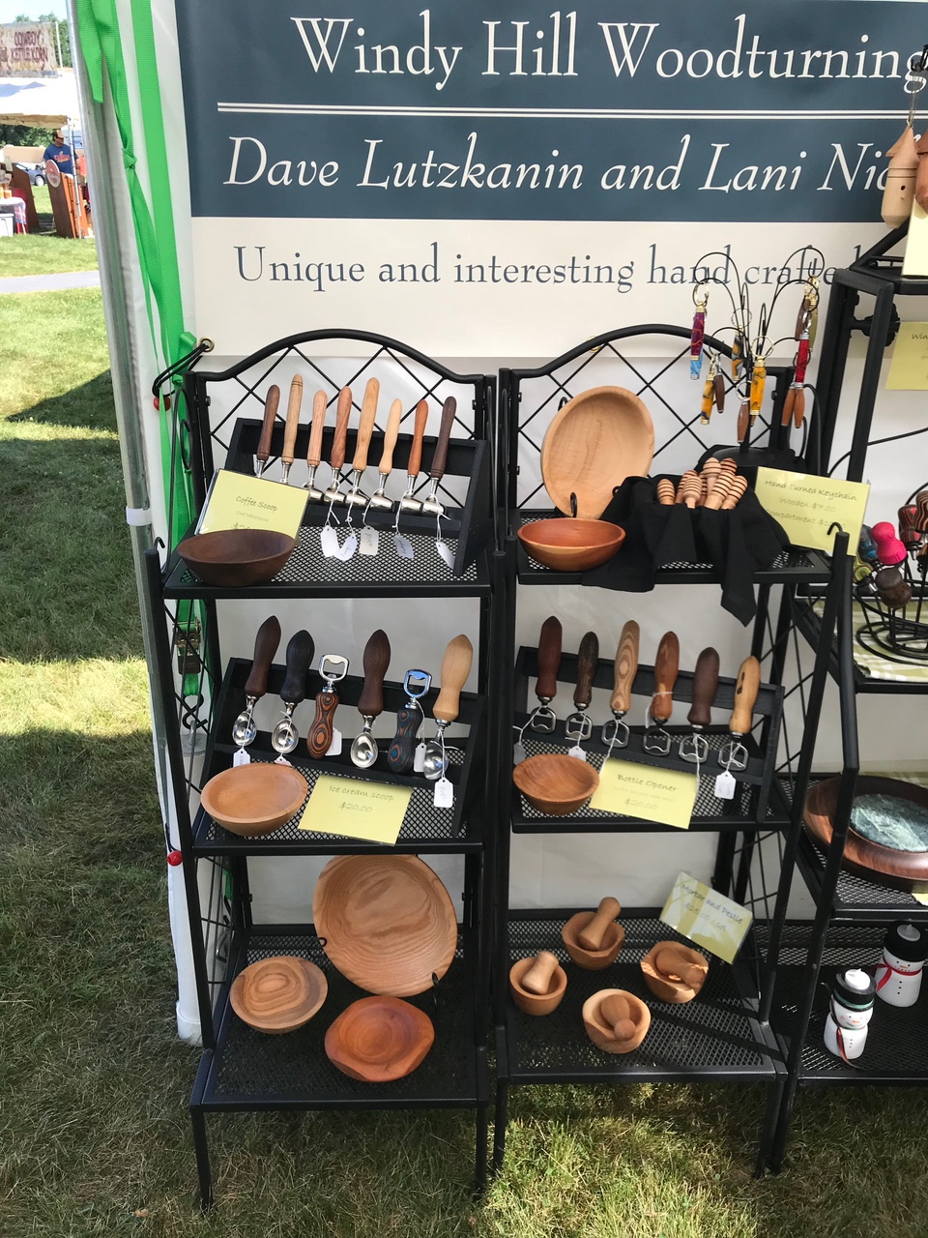

Slide 22
Figures 9 and 10 commentary
Finally our solution to the corner! This rack was conceived by Lani and then constructed by myself. It folds flat for transport and storage.
This rack does several things. First, it was designed in the rear to hold our plastic totes with surplus inventory. It does this extremely well. Customers can not see our surplus now.
Second, it displays its products very efficiently, and also allows for more items to be out. The cheese graters and cheese slicing boards both saw a sales increase with this rack in use. This brings up another valuable point: track your sales at each show. I’ve created a spreadsheet of items sold at every show we have done.
Note the banner. Also note that compared to earlier shows, we now always have the walls on the canopy. This helps for our product to “pop”.

Slide 23
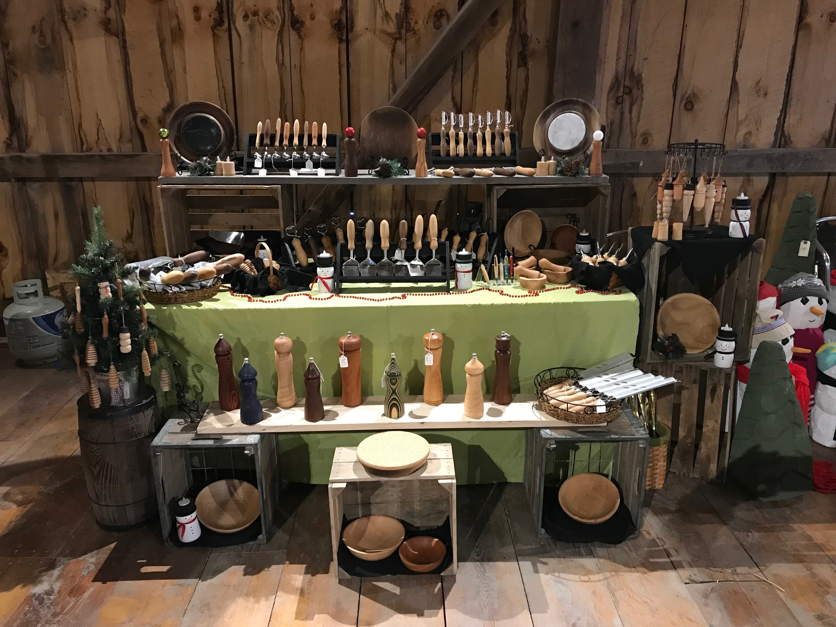

Slide 24
Figure 11 commentary
This is a Thanksgiving weekend show held in a barn. My fiance’ decided to work this show on a whim.
It shows an alternate set up that differs from our usual outside booth. Due to space constraints, pens and razor sets are not on their display rack. In fact, they were not even displayed, but she still sold some!
Note the varying levels used in the display. Even though we are using a table, items are not placed on the table indiscriminately.
Wooden crates can be made, or purchased at yard sales (we have a bunch from yard sales). A board across the span makes a quick and handy shelf.

Slide 25
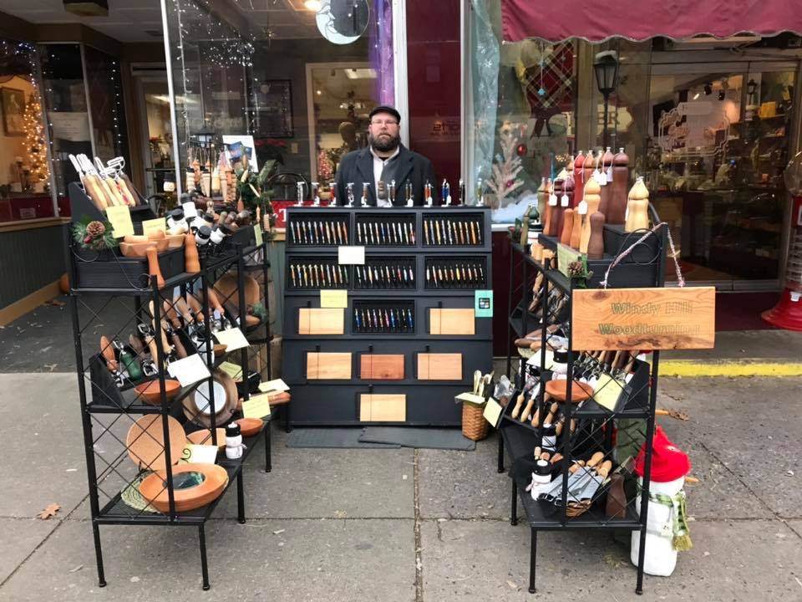

Slide 26
Figure 12 commentary
This is a unique show we do annually at Christmas time. It’s an open air market in the Victorian England style. No canopies permitted and the spaces are much smaller, 5’ by 6’ rather than 10’ by 10’. There are rules on how vendors dress. Vendors must be in period clothing. Notice my top coat and hat. This photo is from December 2018.
Obviously with space constraints, we are limited in our display. This is the show to leave slow selling products at home.

Slide 27
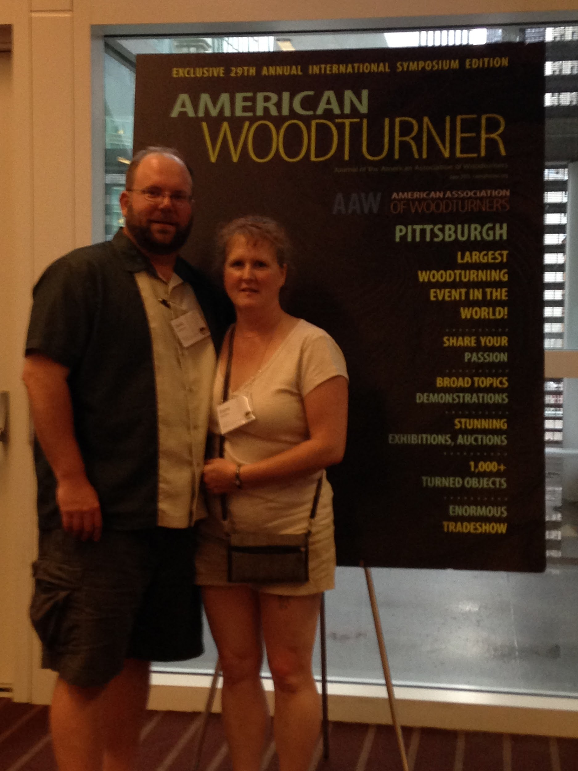
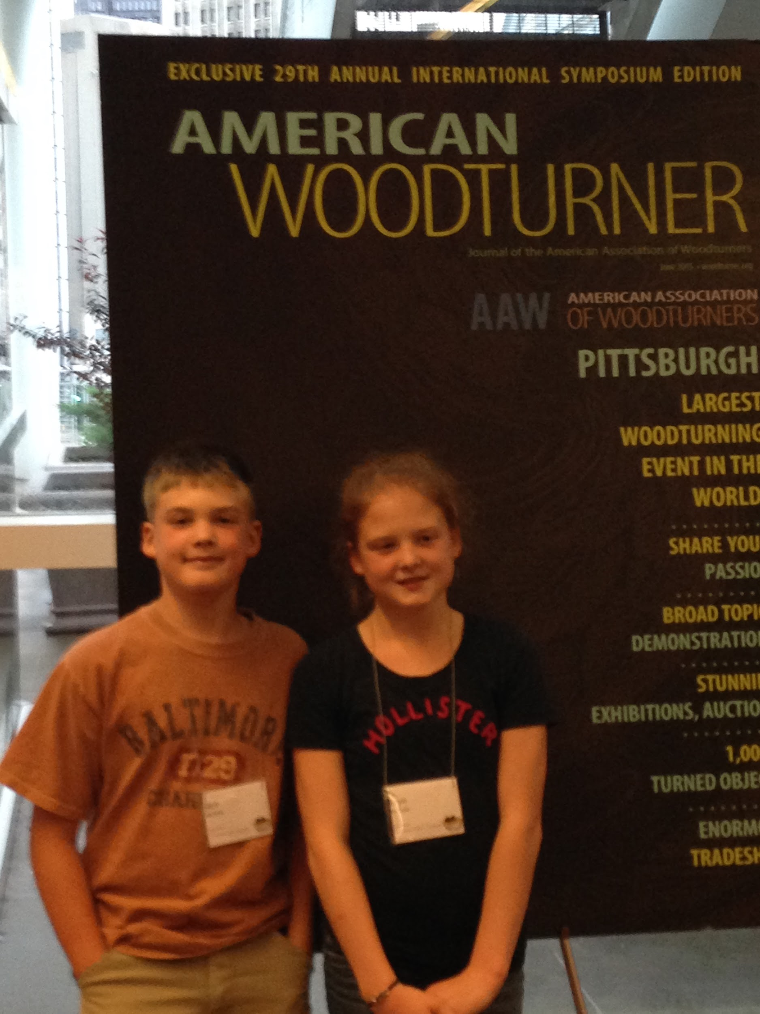
Figure 13

Slide 28
Figure 13 commentary
This is my fiance’ and I at the AAW symposium in Pittsburgh, PA 2015
Also our two children, Eryn and Jace.
Woodturning and craft shows are a family affair!
Jace is old enough that he now assists me in the shop.
Eryn makes signs and helps with other computer things, including the website. They both occasionally turn.

Slide 29
Information
www.windyhillwoodturning.com
Dave Lutzkanin Lani Nichols
dave@windyhillwoodturning.com lani@windyhillwoodturning.com

